Slide 1
Data Mining
Practical Machine Learning Tools and Techniques
Chapter 6: Trees and Rules
Notes:
4/2/2020
1
1

Slide 2
Algorithms for learning trees and rules
Decision trees
From ID3 (Chap. 4.3) to C4.5 (pruning, numeric attributes, ...)
Classification rules
From PRISM (Chap. 4.4) to RIPPER and PART (pruning, numeric data, …)
Association Rules
Faster rule mining with frequent-pattern trees
Notes:
4/2/2020
2
2

Slide 3
Decision Trees

Slide 4
Industrial-strength algorithms
For an algorithm to be useful in a wide range of real-world applications it must:
Permit numeric attributes
Allow missing values
Be robust in the presence of noise
Basic scheme needs to be extended to fulfill these requirements
Notes:
4/2/2020
4
4

Slide 5
From ID3 to C4.5
ID3 algorithm for constructing decision trees:
Covered in Chap. 4.3
Determine splits based on optimizing information-gain
Extending ID3:
to permit numeric attributes: straightforward
to deal sensibly with missing values: trickier
stability for noisy data: requires pruning mechanism
End result: C4.5 (Quinlan)
Best-known and (probably) most widely-used learning algorithm
Commercial successor: C5.0
Notes:
4/2/2020
5
5

Slide 6
Numeric attributes
Standard method: binary splits
E.g. temp < 45
Unlike nominal attributes, every attribute has many possible split points
Solution is straightforward extension:
Evaluate info gain (or other measure) for every possible split point of attribute
Choose “best” split point
Info gain for best split point is info gain for attribute
Computationally more demanding
Notes:
4/2/2020
6
6

Slide 7
Weather data (again!)
Outlook
Outlook
Outlook
Temperature
Temperature
Temperature
Humidity
Humidity
Humidity
Windy
Windy
Windy
Play
Play
Play
Sunny
Sunny
Sunny
Hot
Hot
Hot
High
High
High
False
False
False
No
No
No
Sunny
Sunny
Sunny
Hot
Hot
Hot
High
High
High
True
True
True
No
No
No
Overcast
Overcast
Overcast
Hot
Hot
Hot
High
High
High
False
False
False
Yes
Yes
Yes
Rainy
Rainy
Rainy
Mild
Mild
Mild
Normal
Normal
High
False
False
False
Yes
Yes
Yes
…
…
…
…
…
…
…
…
…
…
…
…
…
…
…
…
…
Rainy
…
…
Cool
…
…
Normal
…
…
False
…
…
Yes
…
…
Rainy
…
…
Cool
…
…
Normal
…
…
True
…
…
No
…
…
…
…
…
…
…
…
…
…
…
…
…
…
…
If outlook = sunny and humidity = high then play = no
If outlook = rainy and windy = true then play = no
If outlook = overcast then play = yes
If humidity = normal then play = yes
If none of the above then play = yes
Notes:
4/2/2020
7
7

Slide 8
Weather data (again!)
Outlook
Outlook
Outlook
Temperature
Temperature
Temperature
Humidity
Humidity
Humidity
Windy
Windy
Windy
Play
Play
Play
Sunny
Sunny
Sunny
Hot
Hot
Hot
High
High
High
False
False
False
No
No
No
Sunny
Sunny
Sunny
Hot
Hot
Hot
Outlook
Outlook
Outlook
High
High
High
Temperature
Temperature
Temperature
True
True
True
Humidity
Humidity
Humidity
No
No
No
Windy
Windy
Windy
Play
Play
Play
Overcast
Overcast
Overcast
Hot
Hot
Hot
Sunny
Sunny
Sunny
High
High
High
Hot
Hot
85
False
False
False
High
High
85
Yes
Yes
Yes
False
False
False
No
No
No
Sunny
Sunny
Sunny
Hot
Hot
80
High
High
90
True
True
True
No
No
Rainy
No
Rainy
Rainy
Mild
Mild
Mild
Normal
Normal
High
False
False
False
Yes
Yes
Yes
…
…
…
…
…
…
Overcast
Overcast
Overcast
…
…
…
Hot
Hot
83
…
…
…
High
High
86
…
…
…
False
False
False
Yes
Yes
…
Yes
…
Rainy
…
…
Cool
…
…
Normal
…
…
False
…
…
Yes
…
…
Rainy
…
…
Cool
Rainy
Rainy
Rainy
…
…
Normal
Mild
Mild
70
…
…
True
Normal
Normal
96
…
…
No
False
False
False
Yes
Yes
Yes
…
…
…
…
…
…
…
…
…
…
…
…
…
…
…
…
…
…
…
…
…
…
…
Rainy
…
…
…
…
…
68
…
…
…
…
…
80
…
…
…
…
…
False
…
…
Yes
…
…
Rainy
…
…
65
…
…
70
…
…
True
…
…
No
…
…
…
…
…
…
…
…
…
…
…
…
…
…
…
If outlook = sunny and humidity = high then play = no
If outlook = rainy and windy = true then play = no
If outlook = overcast then play = yes
If humidity = normal then play = yes
If none of the above then play = yes
If outlook = sunny and humidity > 83 then play = no
If outlook = rainy and windy = true then play = no
If outlook = overcast then play = yes
If humidity < 85 then play = no
If none of the above then play = yes
Notes:
4/2/2020
8
8

Slide 9
Example
Split on temperature attribute:
E.g., temperature < 71.5: yes/4, no/2 temperature ≥ 71.5: yes/5, no/3
Info([4,2],[5,3]) = 6/14 info([4,2]) + 8/14 info([5,3]) = 0.939 bits
Place split points halfway between values
Can evaluate all split points in one pass!
64 65 68 69 70 71 72 72 75 75 80 81 83 85
Yes No Yes Yes Yes No No Yes Yes Yes No Yes Yes No
Notes:
4/2/2020
9
9

Slide 10
Can avoid repeated sorting
Sort instances by the values of the numeric attribute
Time complexity for sorting: O (n log n)
Does this have to be repeated at each node of the tree?
No! Sort order for children can be derived from sort order for parent
Time complexity of derivation: O (n)
Drawback: need to create and store an array of sorted indices for each numeric attribute
Notes:
4/2/2020
10
10

Slide 11
Binary vs multiway splits
Splitting (multi-way) on a nominal attribute exhausts all information in that attribute
Nominal attribute is tested (at most) once on any path in the tree
Not so for binary splits on numeric attributes!
Numeric attribute may be tested several times along a path in the tree
Disadvantage: tree is hard to read
Alternatives:
pre-discretize numeric attributes, or
use multi-way splits instead of binary ones
Notes:
4/2/2020
11
11

Slide 12
Computing multi-way splits
Simple and efficient way of generating multi-way splits: greedy algorithm
But: dynamic programming can find optimum multi-way split in O (n²) time
imp (k, i, j ) is the impurity of the best split of values x_{i} … x_{j} into k sub-intervals
imp (k, 1, i ) = min_{0<j <i} imp (k–1, 1, j ) + imp (1, j+1, i )
imp (k, 1, N ) gives us the best k-way split
In practice, greedy algorithm works as well
Notes:
4/2/2020
12
12

Slide 13
Missing values
C4.5 applies method of fractional instances:
Split instances with missing values into pieces
A piece going down a branch receives a weight proportional to the popularity of the branch
weights sum to 1
Info gain works with fractional instances
use sums of weights instead of counts
During classification, split the instance into pieces in the same way
Merge probability distribution using weights
Notes:
4/2/2020
13
13

Slide 14
Pruning
Prevent overfitting the training data: “prune” the decision tree
Two strategies:
Postpruning take a fully-grown decision tree and discard unreliable parts
Prepruning stop growing a branch when information becomes unreliable
Postpruning is preferred in practice—prepruning can “stop early”
Notes:
4/2/2020
14
14

Slide 15
Prepruning
Based on statistical significance test
Stop growing the tree when there is no statistically significant association between any attribute and the class at a particular node
Most popular test: chi-squared test
Quinlan’s classic tree learner ID3 used chi-squared test in addition to information gain
Only statistically significant attributes were allowed to be selected by the information gain procedure
Notes:
4/2/2020
15
15

Slide 16
Early stopping
a
b
class
1
0
0
0
Pre-pruning may stop the growth process prematurely: early stopping
Classic example: XOR/Parity-problem
No individual attribute exhibits any significant association with the class
Structure is only visible in fully expanded tree
Prepruning won’t expand the root node
But: XOR-type problems rare in practice
And: prepruning faster than postpruning
2
0
1
1
3
1
0
1
4
1
1
0
Notes:
4/2/2020
16
16

Slide 17
Postpruning
First, build full tree
Then, prune it
Fully-grown tree shows all attribute interactions
Problem: some subtrees might be due to chance effects
Two pruning operations:
Subtree replacement
Subtree raising
Possible strategies:
error estimation
significance testing
MDL principle
Notes:
4/2/2020
17
17

Slide 18
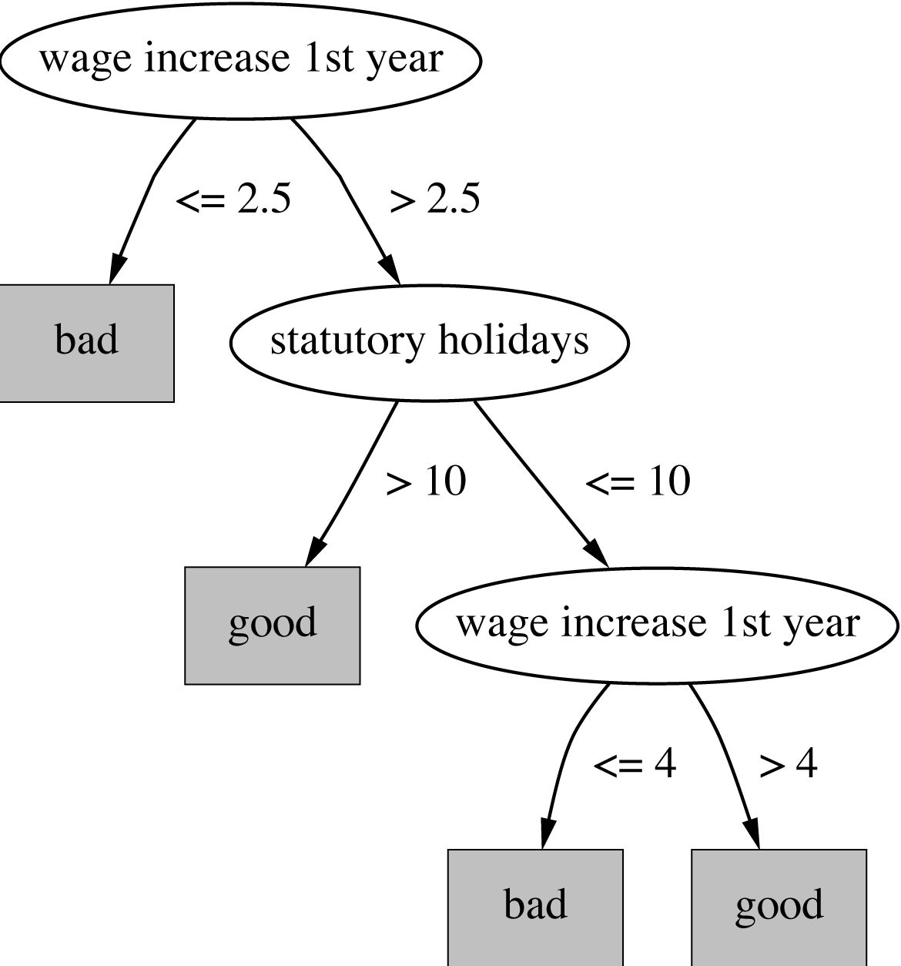
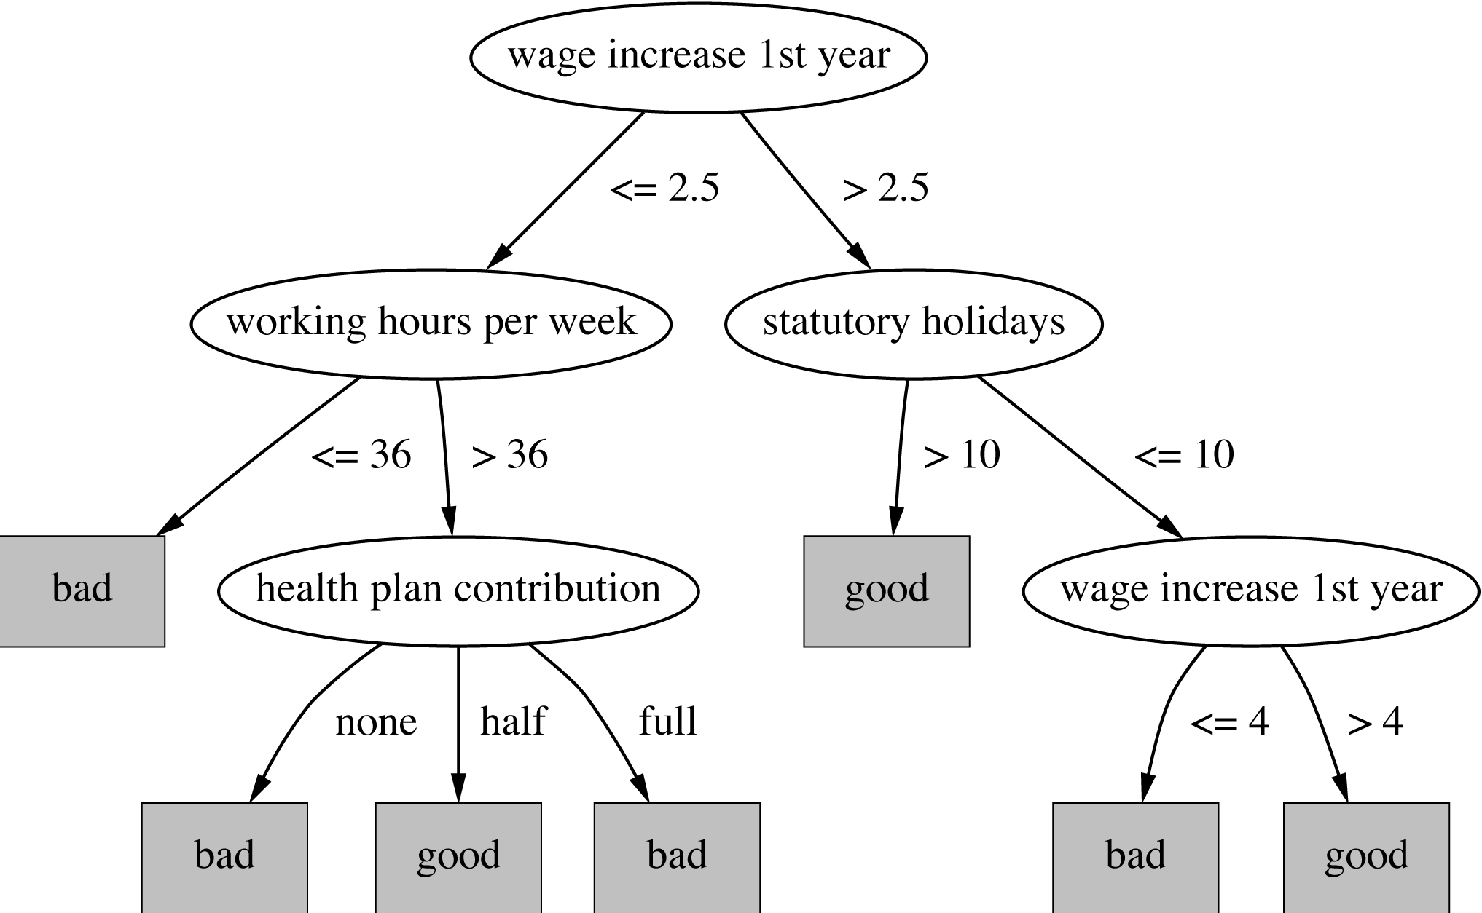
Subtree replacement
Bottom-up
Consider replacing a tree only after considering all its subtrees
Notes:
4/2/2020
18
18

Slide 19
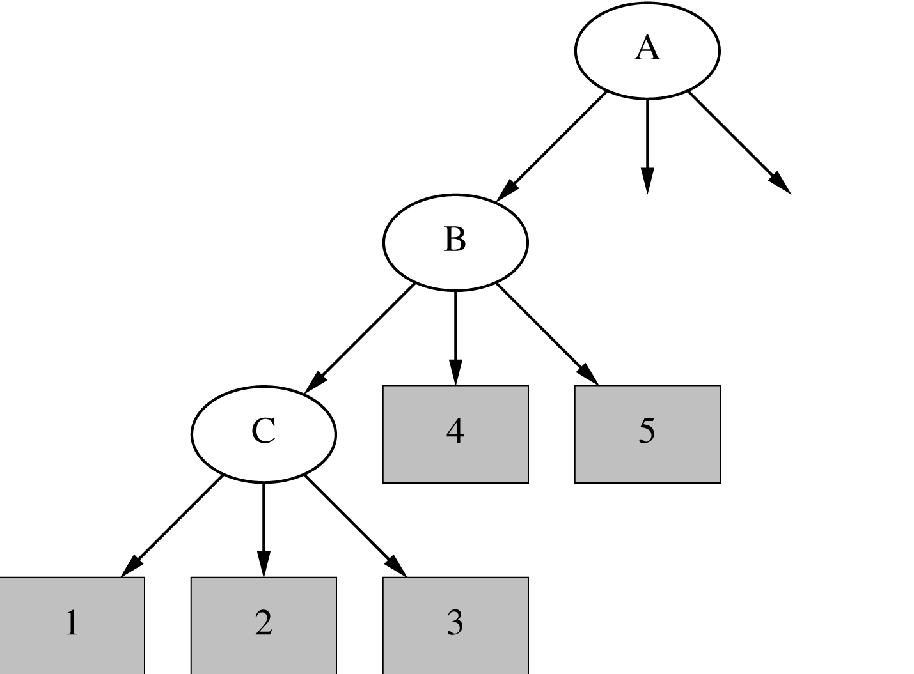
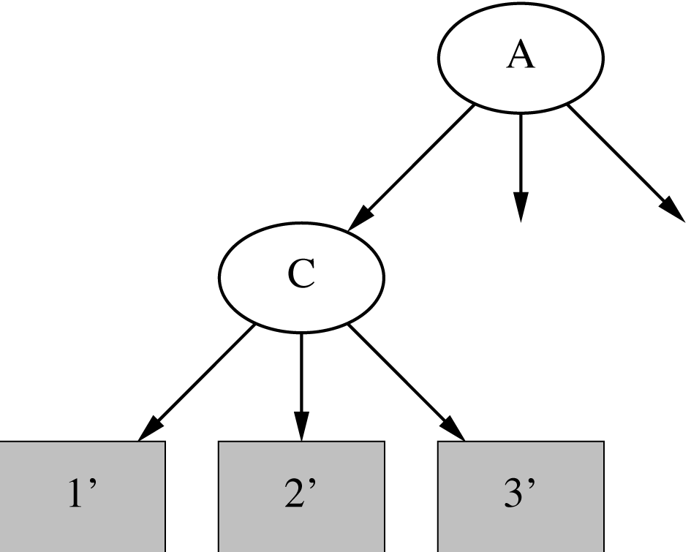
Subtree raising
Delete node
Redistribute instances
Slower than subtree replacement
(Worthwhile?)
Notes:
4/2/2020
19
19

Slide 20
Estimating error rates
Prune only if it does not increase the estimated error
Error on the training data is NOT a useful estimator (would result in almost no pruning)
One possibility: use hold-out set for pruning (yields “reduced-error pruning”)
C4.5’s method
Derive confidence interval from training data
Use a heuristic limit, derived from this, for pruning
Standard Bernoulli-process-based method
Notes:
4/2/2020
20
20

Slide 21
C4.5’s method
Error estimate for subtree is weighted sum of error estimates for all its leaves
Error estimate for a node:
If c = 25% then z = 0.69 (from normal distribution)
f is the error on the training data
N is the number of instances covered by the leaf
Notes:
4/2/2020
21
21

Slide 22
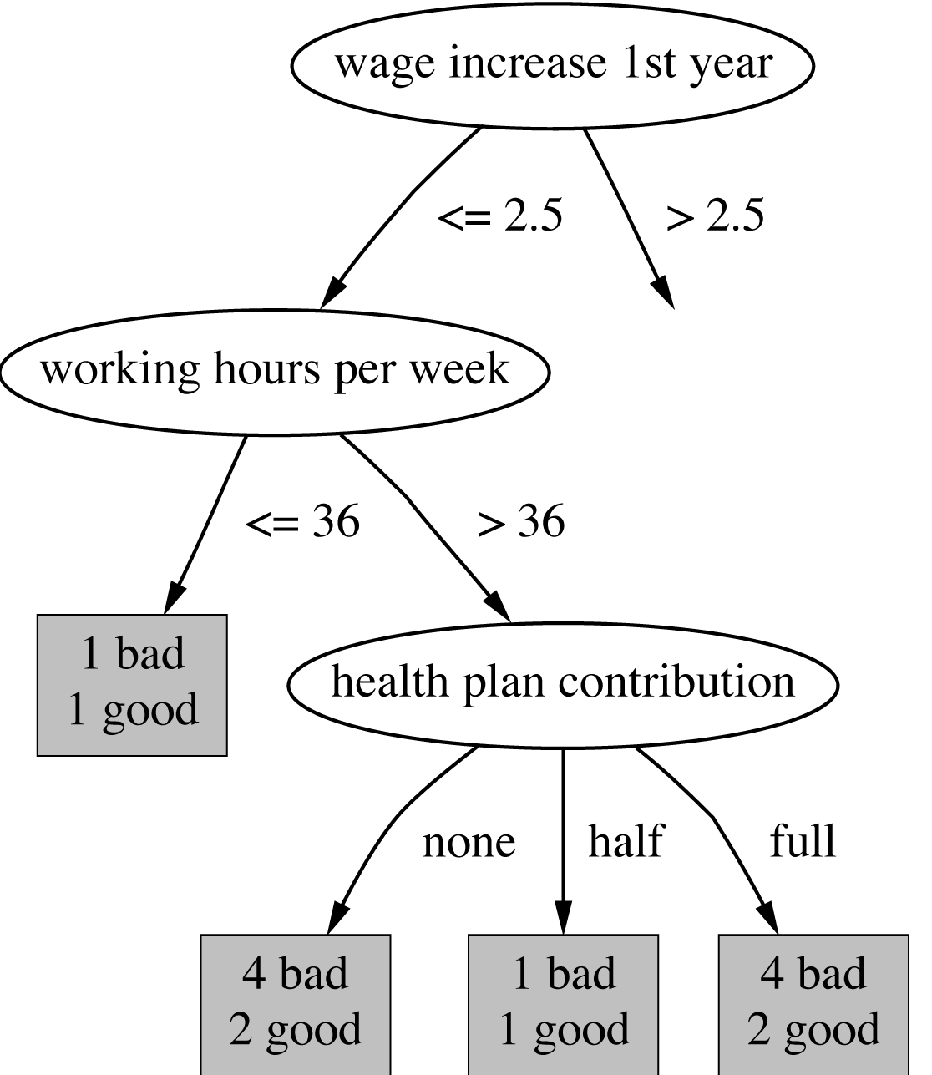
Example
f = 5/14 e = 0.46 e < 0.51 so prune!
f=0.33 e=0.47
f=0.5 e=0.72
f=0.33 e=0.47
Combined using ratios 6:2:6 gives 0.51
Notes:
4/2/2020
22
22

Slide 23
Complexity of tree induction
Assume
m attributes
n training instances
tree depth O (log n)
Building a tree O (m n log n)
Subtree replacement O (n)
Subtree raising O (n (log n)²)
Every instance may have to be redistributed at every node between its leaf and the root
Cost for redistribution (on average): O (log n)
Total cost: O (m n log n) + O (n (log n)²)
Notes:
4/2/2020
23
23

Slide 24
From trees to rules
Simple way: one rule for each leaf
C4.5rules: greedily prune conditions from each rule if this reduces its estimated error
Can produce duplicate rules
Check for this at the end
Then
look at each class in turn
consider the rules that predict that class
find a “good” subset (guided by MDL)
Then rank the subsets to avoid conflicts
Finally, remove rules (greedily) if this decreases error on the training data
Notes:
4/2/2020
24
24

Slide 25
C4.5: choices and options
C4.5 rules slow for large and noisy datasets
Successor algorithm C5.0 rules uses a different technique
Much faster and a bit more accurate
C4.5 has two parameters
Confidence value (default 25%): lower values incur heavier pruning
Minimum number of instances in the two most popular branches (default 2)
Time complexity of C4.5 is actually greater than what was stated above:
For each numeric split point that has been identified, the entire training set is scanned to find the closest actual point
Notes:
4/2/2020
25
25

Slide 26
Cost-complexity pruning
C4.5's postpruning often does not prune enough
Tree size continues to grow when more instances are added even if performance on independent data does not improve
But: it is very fast and popular in practice
Can be worthwhile in some cases to strive for a more compact tree at the expense of more computational effort
Cost-complexity pruning method from the CART (Classification and Regression Trees) learning system achieves this
Applies cross-validation or a hold-out set to choose an appropriate tree size for the final tree
Notes:
4/2/2020
26
26

Slide 27
Cost-complexity pruning details
Basic idea:
First prune subtrees that, relative to their size, lead to the smallest increase in error on the training data
Increase in error (α): average error increase per leaf of subtree
Bottom-up pruning based on this criterion generates a sequence of successively smaller trees
Each candidate tree in the sequence corresponds to one particular threshold value α_{i}
Which tree to chose as the final model?
Use either a hold-out set or cross-validation to estimate the error for each α_{i}
Rebuild tree on entire training set using chosen value of α
Notes:
4/2/2020
27
27

Slide 28
Discussion
TDIDT: Top-Down Induction of Decision Trees
The most extensively studied method of machine learning used in data mining
Different criteria for attribute/test selection rarely make a large difference
Different pruning methods mainly change the size of the resulting pruned tree
C4.5 builds univariate decision trees: each node tests a single attribute
Some TDITDT systems can build multivariate trees (e.g., the famous CART tree learner)
Notes:
4/2/2020
28
28

Slide 29
Discussion and Bibliographic Notes
CART’s pruning method (Breiman et al. 1984) can often produce smaller trees than C4.5’s method
C4.5’s overfitting problems have been investigated empirically by Oates and Jensen (1997)
A complete description of C4.5, the early 1990s version, appears as a excellent and readable book (Quinlan 1993)
An MDL-based heuristic for C4.5 Release 8 that combats overfitting of numeric attributes is described by Quinlan (1998)
The more recent version of Quinlan’s tree learner, C5.0, is also available as open-source code

Slide 30
Classification Rules

Slide 31
Classification rules
Common procedure: separate-and-conquer
Differences:
Search method (e.g. greedy, beam search, ...)
Test selection criteria (e.g. accuracy, ...)
Pruning method (e.g. MDL, hold-out set, ...)
Stopping criterion (e.g. minimum accuracy)
Post-processing step
Also: Decision list vs. one rule set for each class
Notes:
4/2/2020
31
31

Slide 32
Test selection criteria
Basic covering algorithm:
Keep adding conditions to a rule to improve its accuracy
Add the condition that improves accuracy the most
Accuracy measure 1: p/t
t total instances covered by rule p number of these that are positive
Produce rules that don’t cover negative instances, as quickly as possible
May produce rules with very small coverage —special cases or noise?
Measure 2: Information gain p (log(p/t) – log(P/T))
P and T the positive and total numbers before the new condition was added
Information gain emphasizes positive rather than negative instances
Notes:
4/2/2020
32
32

Slide 33
Missing values, numeric attributes
Common treatment of missing values: for any test, they fail
This means the algorithm must either
use other tests to separate out positive instances
leave them uncovered until later in the process
In some cases it is better to treat “missing” as a separate value (i.e., if “missing” has a special significance”
Numeric attributes are treated just like they are in decision trees, with binary split points
Split points are found by optimizing test selection criterion, similar to what happens when finding a split in decision trees
Notes:
4/2/2020
33
33

Slide 34
Pruning rules
Two main strategies:
Incremental pruning
Global pruning
Other difference: pruning criterion
Error on hold-out set (reduced-error pruning)
Statistical significance
MDL principle
Also: post-pruning vs. pre-pruning
Notes:
4/2/2020
34
34

Slide 35
Using a pruning set
For statistical validity, must evaluate measure on data not used for growing the tree:
This requires a growing set and a pruning set
The full training set is split, randomly, into these two sets
Reduced-error pruning : build full rule set on growing set and then prune it
Incremental reduced-error pruning : simplify each rule as soon as it has been built
Can re-split data after rule has been pruned
Stratification is advantageous when applying reduced-error pruning, so that class proportions are preserved
Notes:
4/2/2020
35
35

Slide 36
Incremental reduced-error pruning
Initialize E to the instance set
Until E is empty do
Split E into Grow and Prune in the ratio 2:1
For each class C for which Grow contains an instance
Use basic covering algorithm to create best perfect rule for C
Calculate w(R): worth of rule on Prune and w(R-): worth of rule with final condition omitted
If w(R-) > w(R), prune rule and repeat previous step
From the rules for the different classes, select the one that’s worth most (i.e. with largest w(R))
Print the rule
Remove the instances covered by rule from E
Continue
Notes:
4/2/2020
36
36

Slide 37
Measures of worth used in IREP
[p + (N – n)] / T
(N is total number of negatives)
Counterintuitive:
p = 2000 and n = 1000 vs. p = 1000 and n = 1
Alternative: Success rate p / t
Problem: p = 1 and t = 1 vs. p = 1000 and t = 1001
Another alternative: (p – n) / t
Same effect as success rate because it equals 2p/t – 1
Seems hard to find a simple measure of a rule’s worth that corresponds with intuition
Notes:
4/2/2020
37
37

Slide 38
Variations
Generating rules for classes in order, from smallest class to largest class
Start with the smallest class and learn a rule set for this class, treating all other classes together as the negative class
Remove the smallest class and proceed to learn a rule set for the next-largest class, and so on
Leave the largest class to be covered by the default rule
Stopping criterion
Stop rule production for each if accuracy becomes too low
Rule learner RIPPER applies this strategy
Employs an MDL-based stopping criterion
Employs a post-processing step to modify the generated rules, guided by a criterion based on the MDL principle
Notes:
4/2/2020
38
38

Slide 39
Rule learning using global optimization
RIPPER: Repeated Incremental Pruning to Produce Error Reduction
Performs global optimization in an efficient way
Classes are processed in order of increasing size
Initial rule set for each class is generated using IREP
An MDL-based stopping condition is used
DL: bits needs to send examples wrt set of rules, bits needed to send k tests, and bits for k
Once a rule set has been produced for each class, each rule is re-considered and two variants are produced
One is an extended version, one is grown from scratch
Chooses among three candidates according to DL
Final cleanup step greedily deletes rules to minimize DL
Notes:
4/2/2020
39
39

Slide 40
PART: rule learning using partial trees
PART rule learner avoids global optimization step used in C4.5rules and RIPPER
Generates an unrestricted decision list using the basic separate-and-conquer procedure
In each iteration of the separate-and-conquer algorithm, a rule predicting any of the classes may be added to the rule set
Builds a partial decision tree to obtain each rule
Once partial tree has been generated, one of the leaves of this tree is turned into a rule
A rule is only pruned if all its implications are known
Prevents hasty generalization
Uses C4.5’s tree building procedures to build a tree
Notes:
4/2/2020
40
40

Slide 41
Building a partial tree
Expand-subset (S):
Choose test T and use it to split set of examples into subsets
Sort subsets into increasing order of average entropy
while there is a subset X not yet been expanded AND all subsets expanded so far are leaves
expand-subset(X)
if all subsets expanded are leaves AND estimated error for subtree ≥ estimated error for node
undo expansion into subsets and make node a leaf
Notes:
4/2/2020
41
41

Slide 42
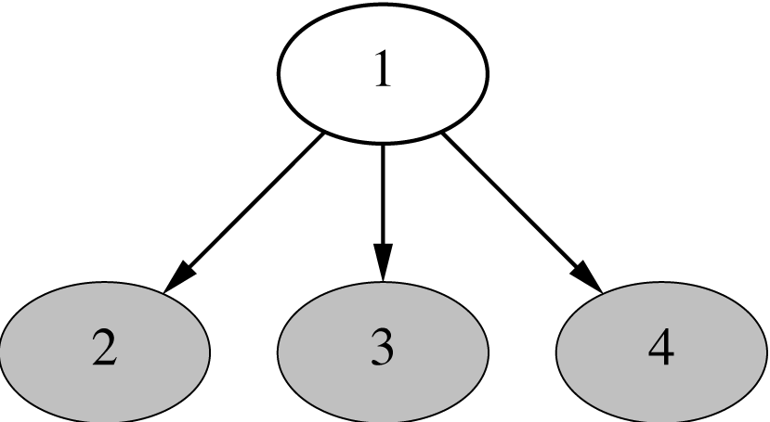
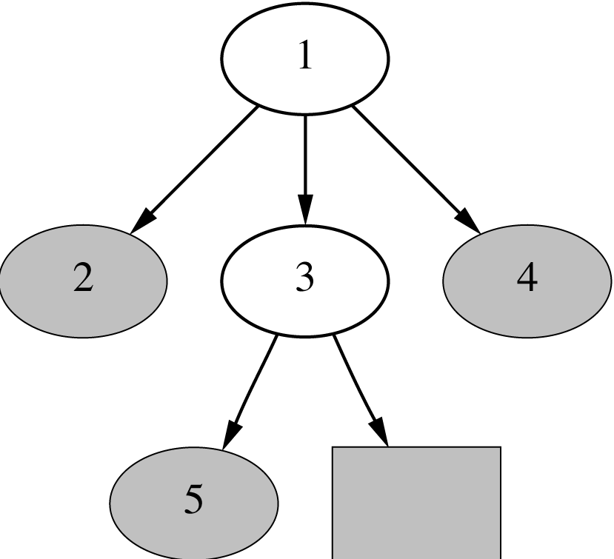
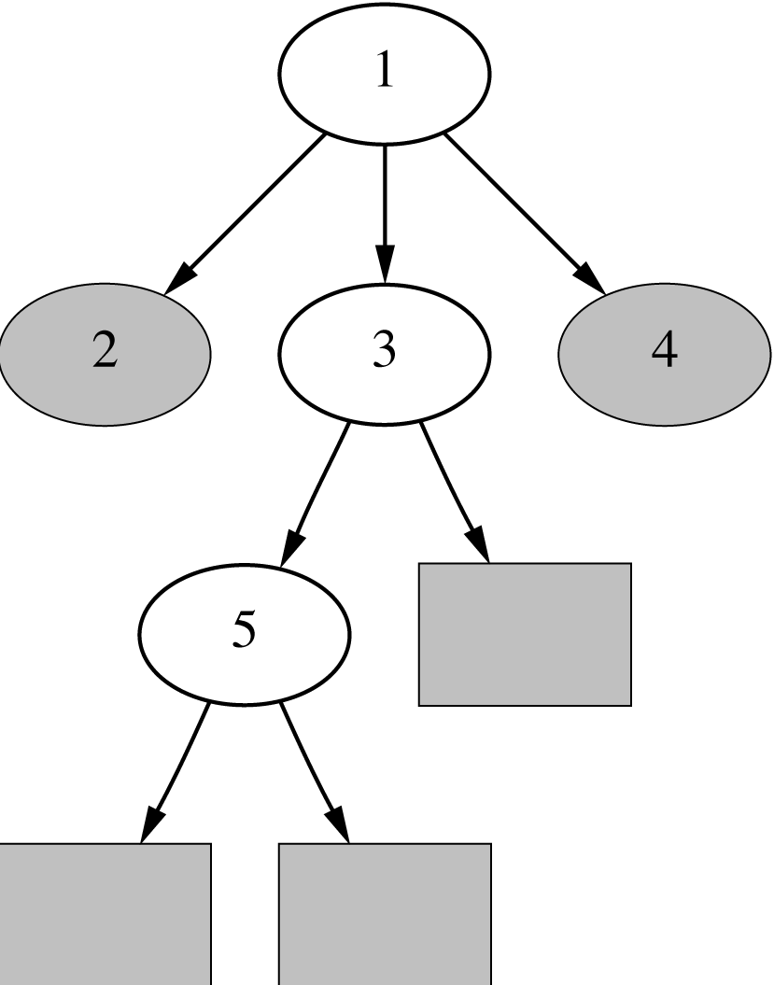
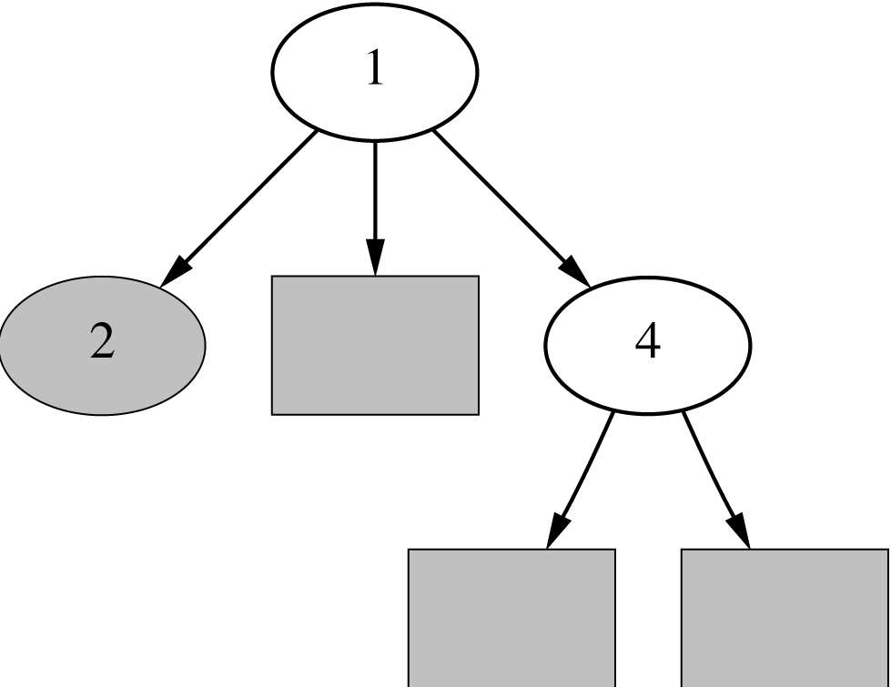
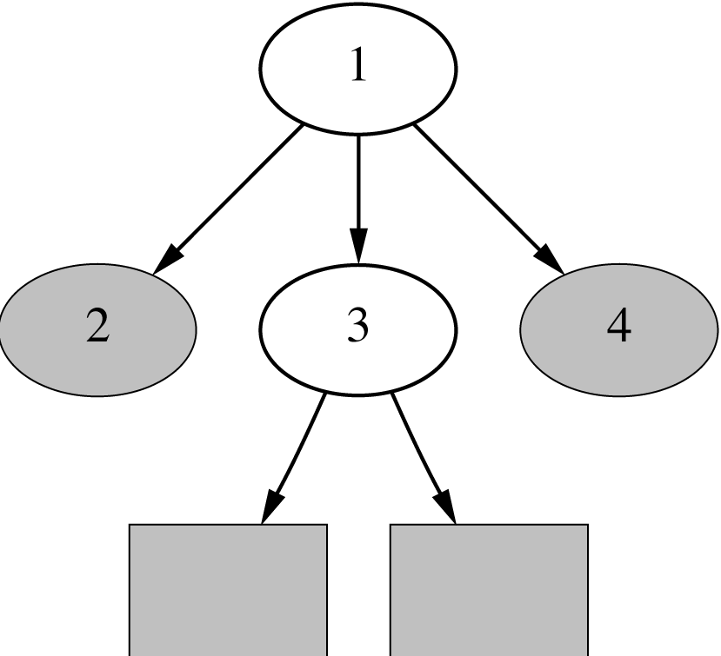
Example
Notes:
4/2/2020
42
42

Slide 43
Notes on PART
Select only one leaf to convert to a rule
Choose leaf with maximum coverage
Treat missing values just as C4.5 does
i.e. split instance with a missing value into pieces
Time taken to generate a rule:
Worst case: same as for building a pruned C4.5 tree
- Occurs when data is noisy and the maximum amount of pruning occurs
Best case: same as for building a single if-then rule using the basic strategy employed by the PRISM rule learner
- Occurs when data is noise free and no pruning occurs
Notes:
4/2/2020
43
43

Slide 44
Rules with exceptions
Assume we have a way of generating a single good rule
Then, in principle, it is easy to generate rules with exceptions
Algorithm for building a tree of rules:
Select default class for top-level rule
Generate a good rule for one of the remaining classes
Apply this method recursively to the two subsets produced by the rule (i.e., instances that are covered/not covered)
Notes:
4/2/2020
44
44

Slide 45
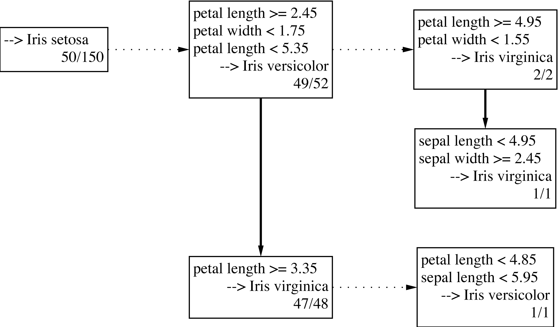
Iris data example
Exceptions are represented as
Dotted paths, alternatives as solid ones.
Notes:
4/2/2020
45
45

Slide 46
Discussion and Bibliographic Notes
The idea of incremental reduced-error pruning is due to Fürnkranz and Widmer (1994)
The RIPPER rule learner is due to Cohen (1995)
What we have presented here is the basic idea of the algorithm; there are many more details in the implementation
An extensive theoretical study of various test selection criteria for rules has been performed by Fürnkranz and Flach (2005)
The rule-learning scheme based on partial decision trees was developed by Frank and Witten (1998)
The procedure for generating rules with exceptions was part of Gaines and Compton’s Induct system (1995)
They called rules with exceptions ripple-down rules
Richards and Compton (1998) describe their role as an alternative to classic knowledge engineering

Slide 47
Association Rules

Slide 48
Association rules
The Apriori algorithm finds frequent item sets via a generate-and-test methodology
Successively longer item sets are formed from shorter ones
Each different size of candidate item set requires a full scan of the dataset
Combinatorial nature of generation process is costly – particularly if there are many item sets, or item sets are large
Appropriate data structures can help
The FP-growth algorithm for finding frequent item sets employs an extended prefix tree (FP-tree)
Notes:
4/2/2020
48
48

Slide 49
FP-growth
FP-growth uses a Frequent Pattern Tree (FP-tree) to store a compressed version of the data
Only two passes through a dataset are required to map the data into an FP-tree
The tree is then processed recursively to “grow” large item sets directly
Avoids generating candidate item sets that need to be tested against the entire database
Notes:
4/2/2020
49
49

Slide 50
Building a frequent pattern tree
First pass over the data: count the number times individual items occur
Second pass over the data: before inserting each instance into the FP-tree, sort its items in descending order of their frequency of occurrence
- Individual items that do not meet the minimum support are not inserted into the tree
- Ideally, many instances will share items that occur frequently individually, resulting in a high degree of compression close to the root of the tree
Notes:
4/2/2020
50
50

Slide 51
An example using the weather data
Frequency of individual items (minimum support = 6)
play = yes 9
windy = false 8
humidity = normal 7
humidity = high 7
windy = true 6
temperature = mild 6
play = no 5
outlook = sunny 5
outlook = rainy 5
temperature = hot 4
temperature = cool 4
outlook = overcast 4
Notes:
4/2/2020
51
51

Slide 52
An example using the weather data
Instances with items sorted
1 windy=false, humidity=high, play=no, outlook=sunny, temperature=hot
2 humidity=high, windy=true, play=no, outlook=sunny, temperature=hot
3 play=yes, windy=false, humidity=high, temperature=hot, outlook=overcast
4 play=yes, windy=false, humidity=high, temperature=mild, outlook=rainy
.
.
.
14 humidity=high, windy=true, temperature=mild, play=no, outlook=rainy
Final answer: six single-item sets (previous slide) plus two multiple-item sets that meet minimum support
play=yes and windy=false 6
play=yes and humidity=normal 6
Notes:
4/2/2020
52
52

Slide 53
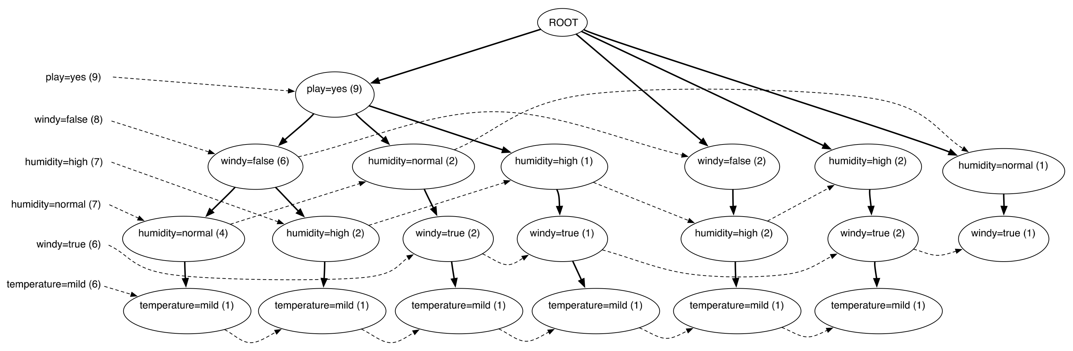
Finding large item sets
FP-tree for the weather data (min support 6)
Process header table (shown on left) from bottom
Add temperature=mild to the list of large item sets
Are there any item sets containing temperature=mild that meet the minimum support?
Notes:
4/2/2020
53
53

Slide 54
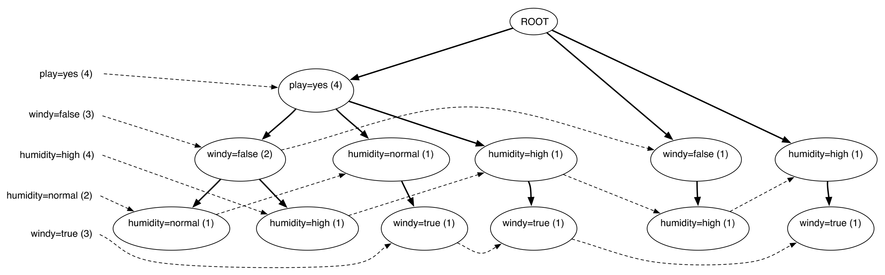
Finding large item sets cont.
FP-tree for the data conditioned on temperature=mild
Created by scanning the first (original) tree
Follow temperature=mild link from header table to find all instances that contain temperature=mild
Project counts from original tree
Header table shows that temperature=mild cannot be grown any longer
Notes:
4/2/2020
54
54

Slide 55
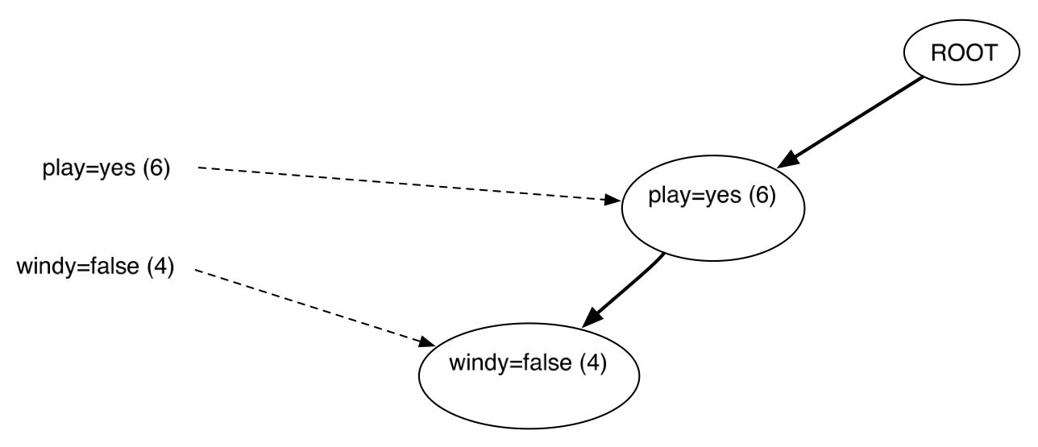
Finding large item sets cont.
FP-tree for the data conditioned on humidity=normal
Created by scanning the first (original) tree
Follow humidity=normal link from header table to find all instances that contain humidity=normal
Project counts from original tree
Header table shows that humidity=normal can be grown to include play=yes
Notes:
4/2/2020
55
55

Slide 56
Finding large item sets cont.
All large item sets have now been found
However, in order to be sure it is necessary to process the entire header link table from the original tree
Association rules are formed from large item sets in the same way as for Apriori
FP-growth can be up to an order of magnitude faster than Apriori for finding large item sets
Notes:
4/2/2020
56
56

Slide 57
Discussion and Bibliographic Notes
The FP-tree and the FP-growth algorithm were introduced by Han et al. (2000) following pioneering work by Zaki et al. (1997)
Han et al. (2004) give a more comprehensive description; the algorithm has been extended in various ways
Wang et al. (2003) develop an algorithm called CLOSET+ to mine closed item sets
Close item sets are sets for which there is no proper superset that has the same support
Produces few redundant rules and thus eases the task that users face when examining the output of the mining process
GSP, for Generalized Sequential Patterns, is a method for mining patterns in event sequences (Srikant and Agrawal, 1996)
An approach like FP-growth is used for event sequences by PrefixSpan (Pei et al., 2004) and CloSpan (Yan et al., 2003)
For graph patterns, there is gSpan (Yan and Han, 2002) and CloseGraph (Yan and Han, 2003)

